Slide 1
CS 5187: Vision and Image
Lecture 2-2
Color and Texture
Dr. Dapeng Oliver Wu
City University of Hong Kong
Department of Computer Science
Semester A, 2026/2027

Slide 2
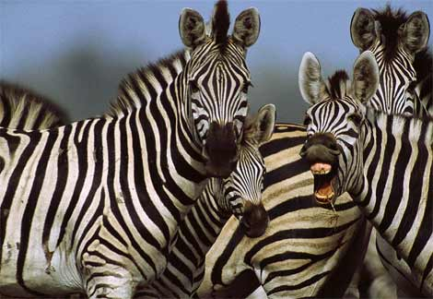
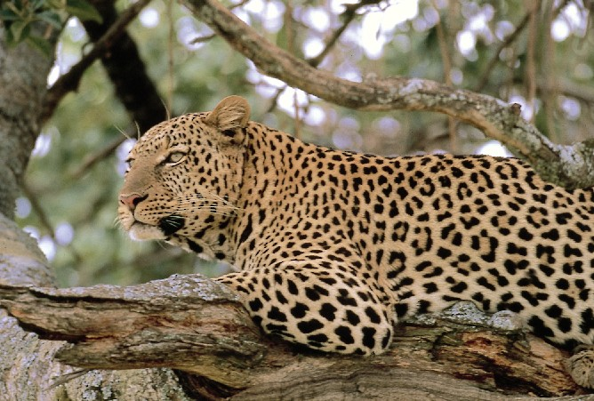
Color and Texture

Slide 3
Color Spaces
RGB
HSI/HSV
YIQ
and more
standard for cameras
hue, saturation, intensity
color TVs, Y is intensity

Slide 4
RGB Color Space
Absolute Normalized
Normalized red r = R/(R+G+B)
Normalized green g = G/(R+G+B)
Normalized blue b = B/(R+G+B)
(0,0,255)
blue
R,G,B
(0,0,0)
(0,255,0)
red
green
(255,0,0)

Slide 5
Color hexagon for HSI (HSV)
Hue is encoded as an angle (0 to 2π).
Saturation is the distance to the vertical axis (0 to 1).
Intensity is the height along the vertical axis (0 to 1).
Notes:
The hue (H) of a color refers to which pure color it resembles. All tints, tones and shades of red have the same hue.
Hues are described by a number that specifies the position of the corresponding pure color on the color wheel, as a fraction between 0 and 1. Value 0 refers to red; 1/6 is yellow; 1/3 is green; and so forth around the color wheel.
The saturation (S) of a color describes how white the color is. A pure red is fully saturated, with a saturation of 1; tints of red have saturations less than 1; and white has a saturation of 0.
The value (V) of a color, also called its lightness, describes how dark the color is. A value of 0 is black, with increasing lightness moving away from black.

Slide 6
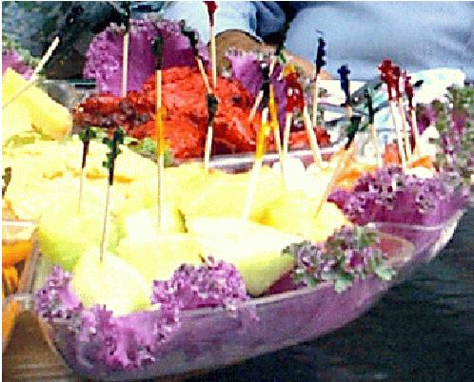
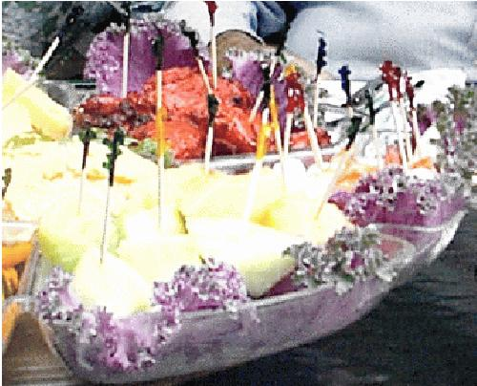
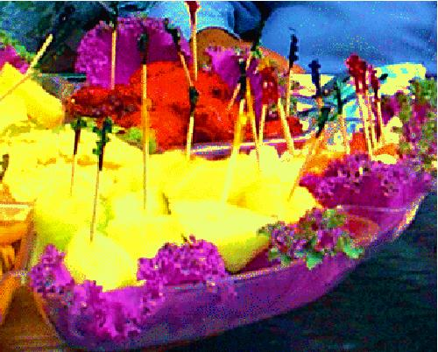
Editing Saturation of Colors
(Left) Image of food originating from a digital camera;
(center) saturation value of each pixel decreased 20%;
(right) saturation value of each pixel increased 40%.

Slide 7
Histograms
A histogram of a gray-tone image is an array H[*] of bins, one for each gray tone.
H[i] gives the count of how many pixels of an image have gray tone i.
P[i] (the normalized histogram) gives the percentage of pixels that have gray tone i.

Slide 8
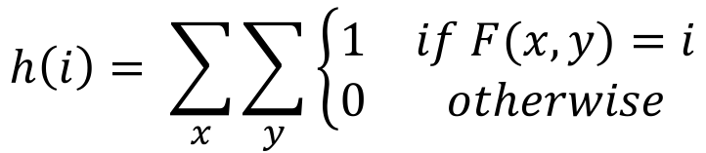
Gray image histogram
$$h\left(i\right)= \sum_{x}{\sum_{y}{\left\{\begin{matrix}1 & if F(x,y)=i \\ 0 & otherwise\end{matrix}\right.}}$$

Slide 9
Color histograms can represent the distribution of pixel values
Histogram is fast and easy to compute.
Size can easily be normalized so that different image histograms can be compared.
Can match color histograms for database query or classification.

Slide 10
How to make a color histogram
Make a single histogram for 3D color vectors.
Make 3 scalar histograms (not so useful)
Notes:
r’ = r/(r+g+b)
g’ = g/(r+b+g)
b’ = b/(r+g+b)
b’ = 1-r’-g’, which can be ignored in representation

Slide 11
Swain and Ballard’s Histogram Matching for Color Object Recognition
(IJCV Vol 7, No. 1, 1991)
Opponent Encoding:
Histograms: 8 x 16 x 16 = 2048 bins
Intersection of image histogram and model histogram:
Match score is the normalized intersection:
wb = R + G + B
rg = R - G
by = 2B - R - G
numbins
intersection(h(I),h(M)) = ∑ min{h(I)[j],h(M)[j]}
j=1
numbins
match(h(I),h(M)) = intersection(h(I),h(M)) / ∑ h(M)[j]
j=1
Notes:
The rg, by, and wb axes are analogous to the opponent color axes used by the human visual system (Lennie & D'Zmura 1988). They were used here simply to allow the intensity (wb) axis to be more coarsely sampled than the other two, because the intensity axis is more sensitive to lighting variation from shadows and distance from the light source. The wb axis was divided into 8 sections, while the rg and by bins were each divided into 16 sections, for a total of 2048 bins.

Slide 12
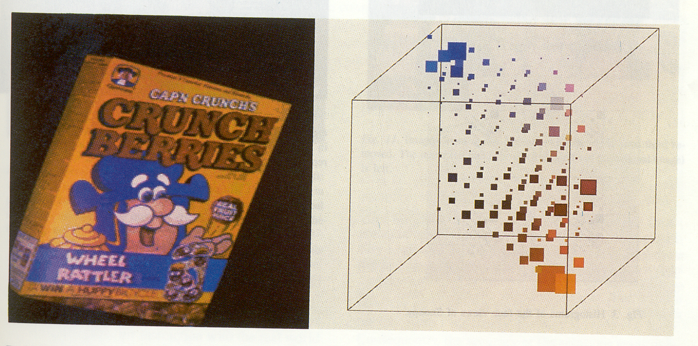
(from Swain and Ballard)
cereal box image
3D color histogram

Slide 13
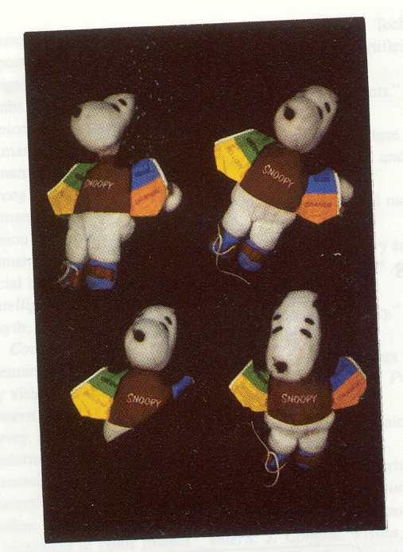
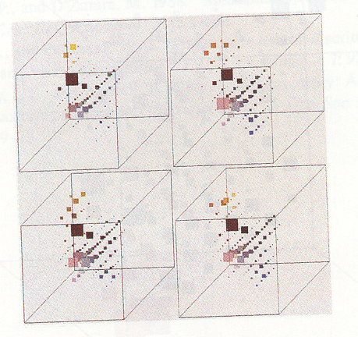
Four views of Snoopy Histograms

Slide 14

Multi-scale spatial color representation
Divide an image into$N×N$ grids at multiple scales
Compute color histogram for each grid
Concatenate all the histograms across scales and grids as a feature vector
Notes:
r’ = r/(r+g+b)
g’ = g/(r+b+g)
b’ = b/(r+g+b)
b’ = 1-r’-g’, which can be ignored in representation

Slide 15
Quiz
Which of the following about the color histogram is correct?
It is invariant to 2D rotation
It is invariant to 3D rotation
It is invariant to change in camera-to-object distance
Notes:
r’ = r/(r+g+b)
g’ = g/(r+b+g)
b’ = b/(r+g+b)
b’ = 1-r’-g’, which can be ignored in representation

Slide 16
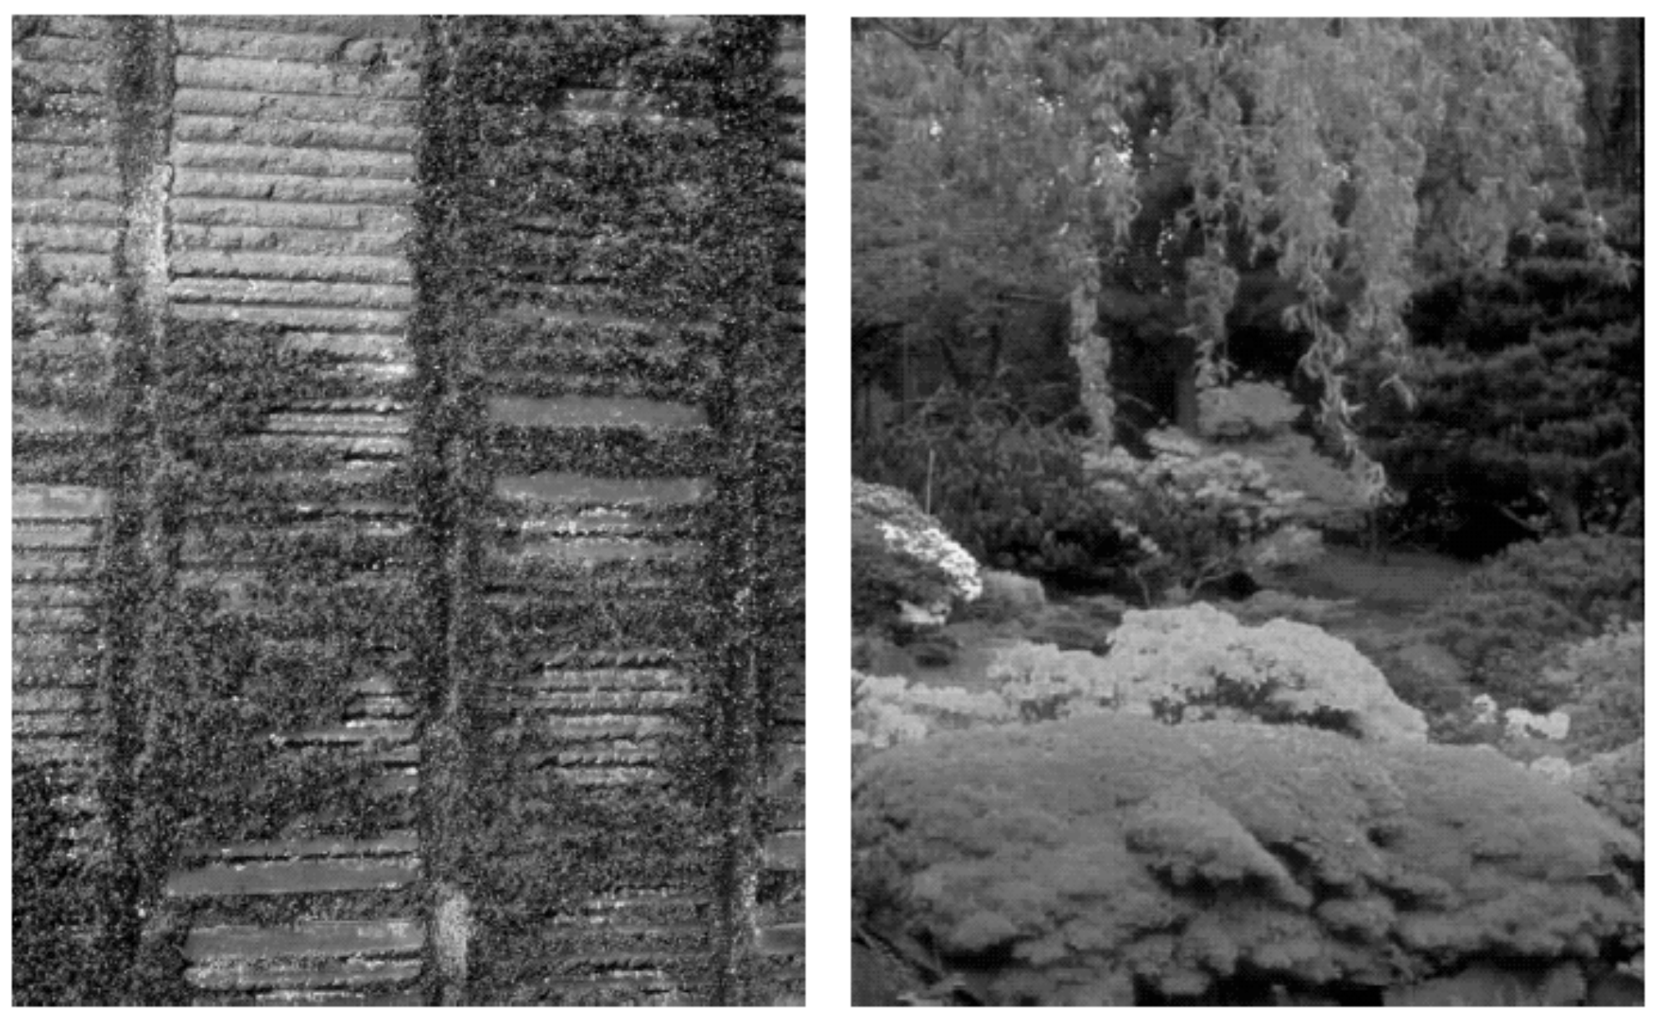
Texture
Color is well defined.
But what is texture?

Slide 17
Structural Texture
Texture is a description of the spatial arrangement of color or
intensities in an image or a selected region of an image.
Structural approach: a set of texels in some regular or repeated pattern

Slide 18
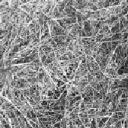
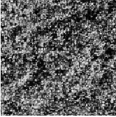
Natural Textures from VisTex
grass
leaves
What/Where are the texels?

Slide 19
The Case for Statistical Texture
Segmenting out texels is difficult or impossible in natural images.
Numeric quantities or statistics that describe a texture can be
computed from the gray tones (or colors) alone.
This approach is less intuitive but computationally efficient.
It can be used for both classification and segmentation.

Slide 20
Some Simple Statistical Texture Measures
1. Edge Density and Direction
Use an edge detector as the first step in texture analysis.
The number of edge pixels in a fixed-size region tells us
how busy that region is.
The directions of the edges also help characterize the texture

Slide 21
Two Edge-based Texture Measures
1. edgeness per unit area (measure of texture richness)
2. edge magnitude and direction histograms (measure of texture uniqueness)
Fedgeness = |{ p | gradient_magnitude(p) ≥ threshold}| / N
where N is the size of the unit area
Fmagdir = ( Hmagnitude, Hdirection )
where these are the normalized histograms of gradient
magnitudes and gradient directions, respectively.

Slide 22
Local Binary Pattern Measure
For each pixel p, create an 8-bit number b1 b2 b3 b4 b5 b6 b7 b8,
where bi = 0 if neighbor i has value less than or equal to p’s
value and 1 otherwise.
Represent the texture in the image (or a region) by the
histogram of these numbers.
1 2 3
100 101 103
40 50 80
50 60 90
4
5
8
1 1 1 1 1 1 0 0
7 6

Slide 23
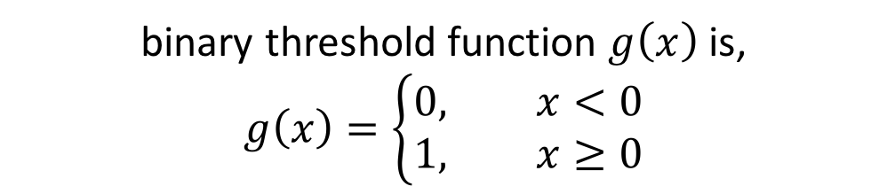
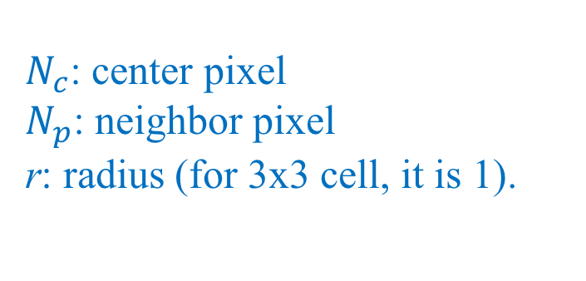
Local Binary Pattern (LBP)
$N_{c}$: center pixel
$N_{p}$: neighbor pixel
r: radius (for 3x3 cell, it is 1).
binary threshold function $g\left(x\right)$ is,
$$g\left(x\right)=\left\{\begin{aligned}0, &x<0 \\ 1, &x≥0\end{aligned}\right.$$

Slide 24
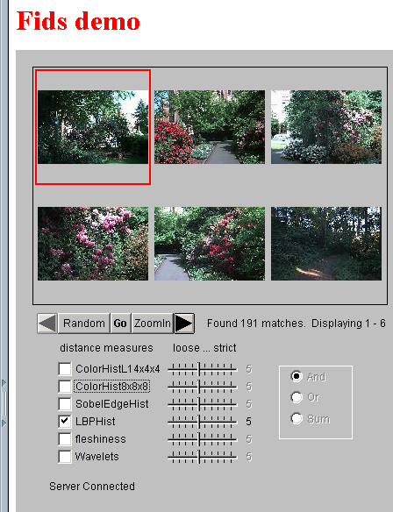
Example
Fids (Flexible Image Database
System) is retrieving images
similar to the query image
using LBP texture as the
texture measure and comparing
their LBP histograms

Slide 25
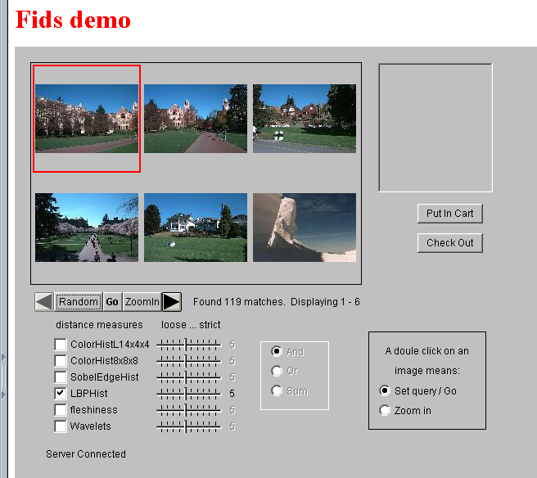
Example
Low-level
measures don’t
always find
semantically
similar images.

Slide 26
Co-occurrence Matrix Features
A co-occurrence matrix is a 2D array C in which
Both the rows and columns represent a set of possible
image values.
C (i,j) indicates how many times value i co-occurs with
value j in a particular spatial relationship d.
The spatial relationship is specified by a vector d = (dr,dc).
d

Slide 27
Co-occurrence Example
1
0 1 2
1 1 0 0
1 1 0 0
0 0 2 2
0 0 2 2
0 0 2 2
0 0 2 2
i
j
0
1
2
1 0 3
2 0 2
0 0 1
3
C_{d}
d = (3,1)
co-occurrence
matrix
gray-tone
image
From C_{d} we can compute N_{d}, the normalized co-occurrence matrix,
where each value is divided by the sum of all the values.

Slide 28
But how do you choose d?
This is actually a critical question with all the
statistical texture methods.
Are the “texels” tiny, medium, large, all three …?
Not really a solved problem.

Slide 29
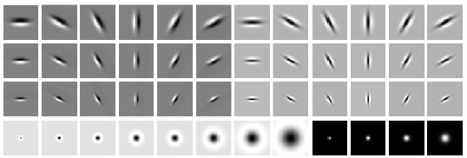
Filter banks
orientations
scales
“Edges”
“Bars”
“Spots”
What filters to put in the bank?
  Typically we want a combination of scales and orientations, different types of patterns.
Kristen Grauman

Slide 30
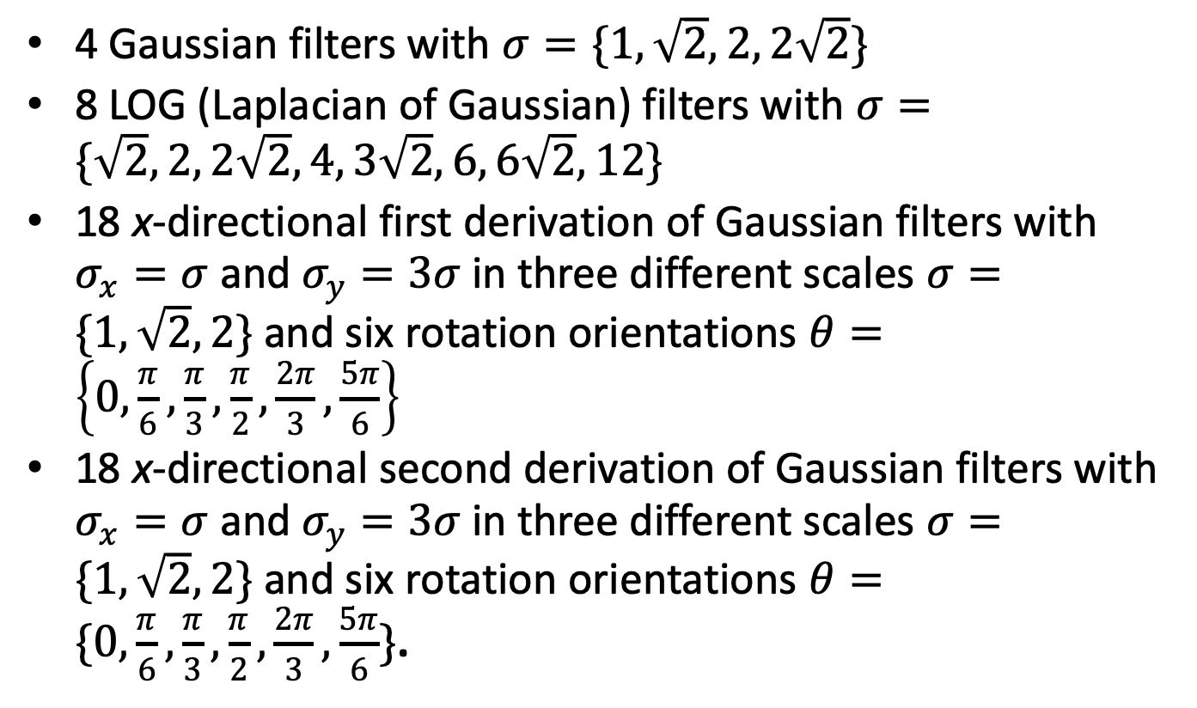
Filter banks
4 Gaussian filters with $σ=\{1,\sqrt{2}, 2, 2\sqrt{2}\}$
8 LOG (Laplacian of Gaussian) filters with $σ=\{\sqrt{2}, 2, 2\sqrt{2}, 4, 3\sqrt{2}, 6, 6\sqrt{2}, 12\}$
18 x-directional first derivation of Gaussian filters with $σ_{x}=σ$ and $σ_{y}=3σ$ in three different scales $σ=\{1,\sqrt{2}, 2\}$ and six rotation orientations $θ=\left\{0, \frac{π}{6}, \frac{π}{3}, \frac{π}{2}, \frac{2π}{3}, \frac{5π}{6}\right\}$
18 x-directional second derivation of Gaussian filters with $σ_{x}=σ$ and $σ_{y}=3σ$ in three different scales $σ=\{1,\sqrt{2}, 2\}$ and six rotation orientations $θ=\{0, \frac{π}{6}, \frac{π}{3}, \frac{π}{2}, \frac{2π}{3}, \frac{5π}{6}\}$.

Slide 31
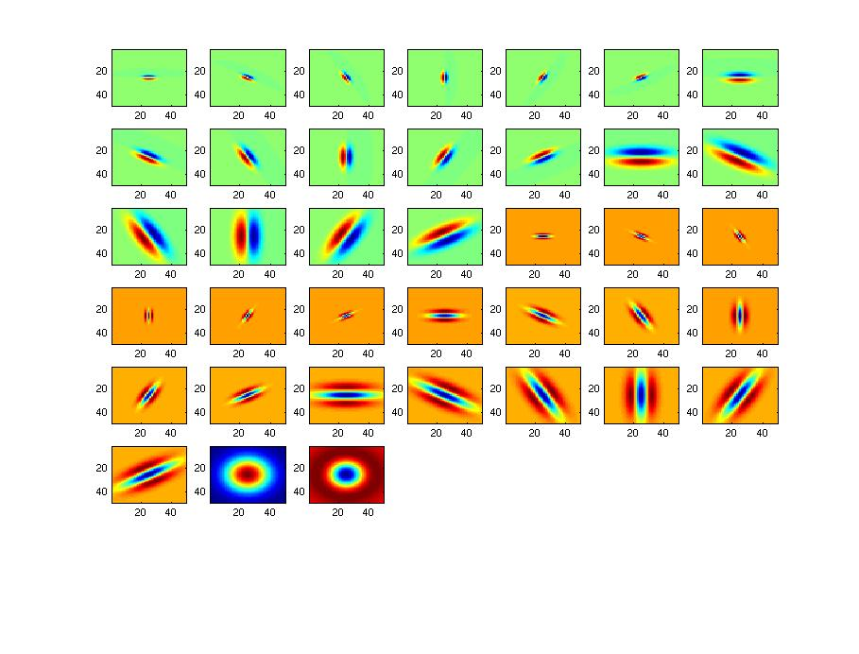
Filter bank
Kristen Grauman

Slide 32
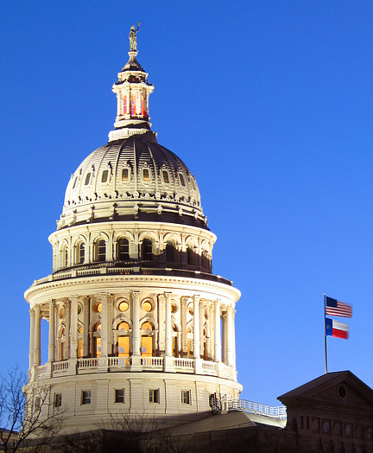
Image from http://www.texasexplorer.com/austincap2.jpg
Kristen Grauman

Slide 33
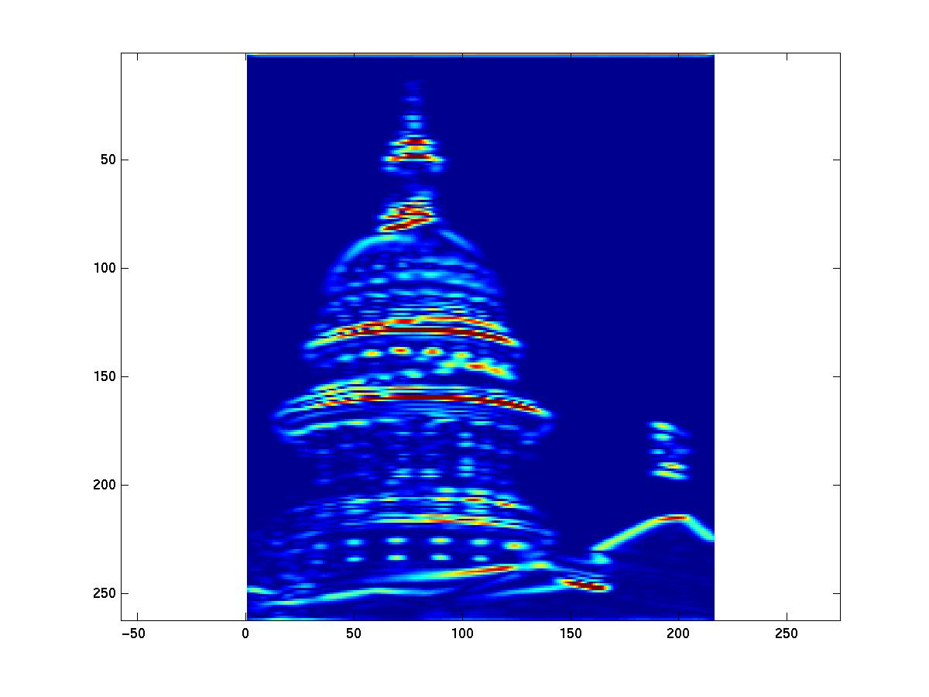
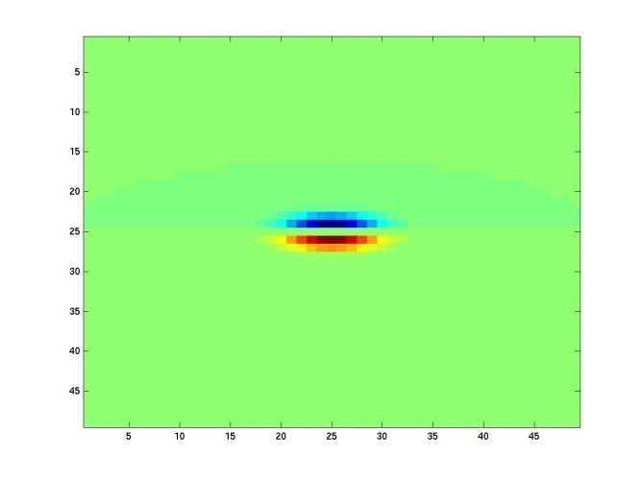
Showing magnitude of responses
Kristen Grauman

Slide 34
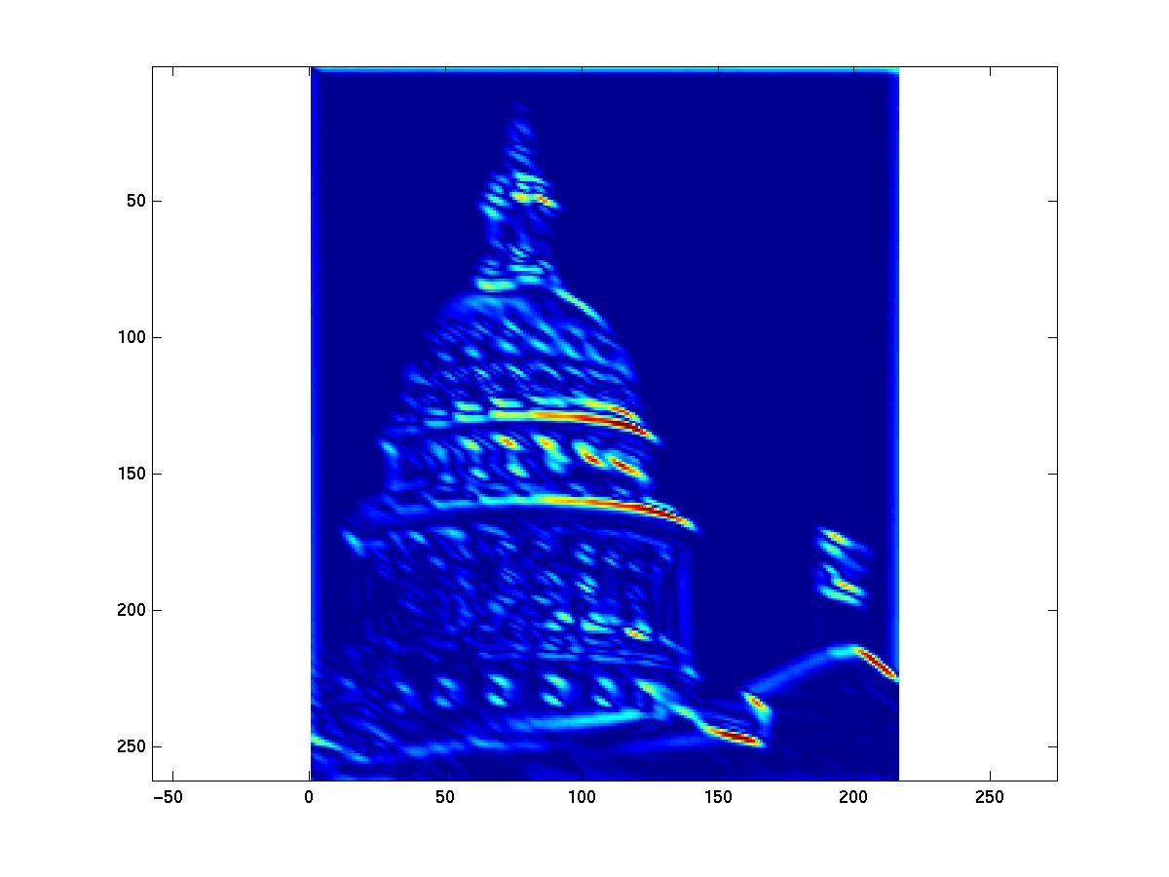
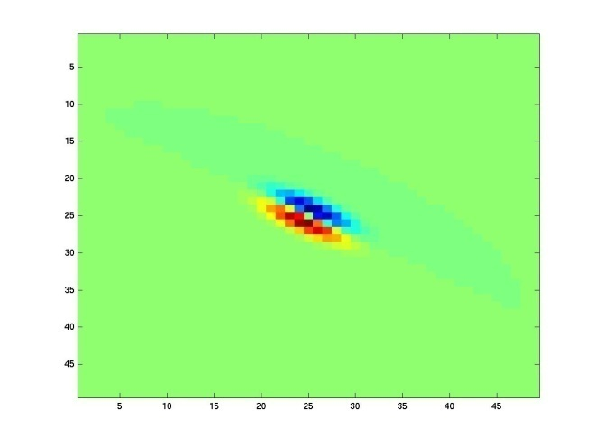
Kristen Grauman
Notes:
2

Slide 35
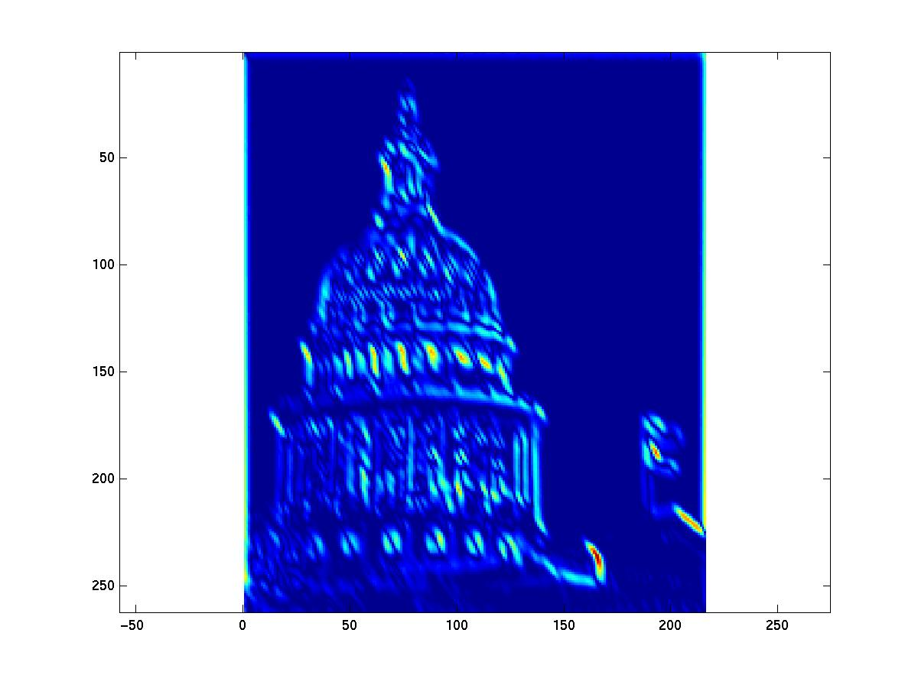
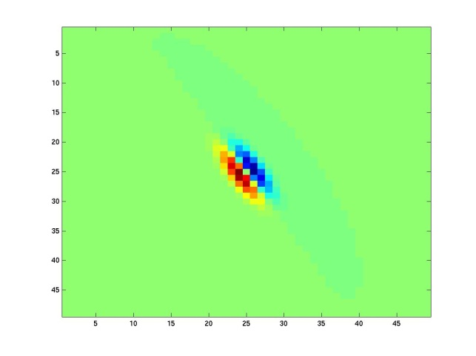
Kristen Grauman
Notes:
3

Slide 36
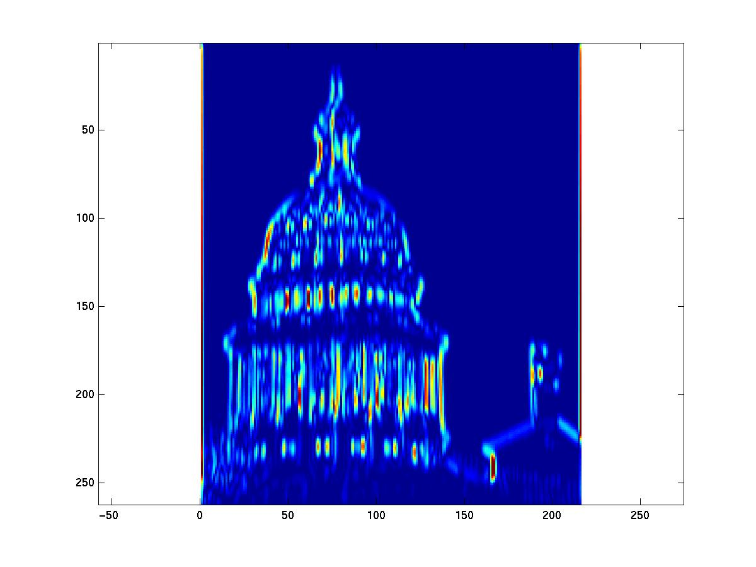
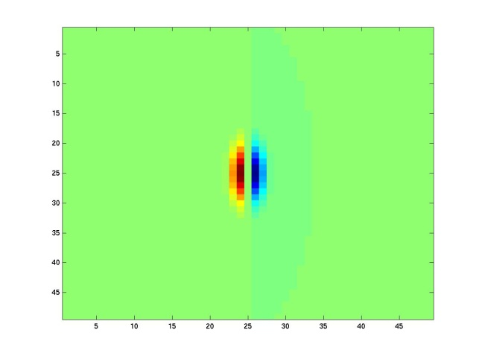
Kristen Grauman
Notes:
4

Slide 37
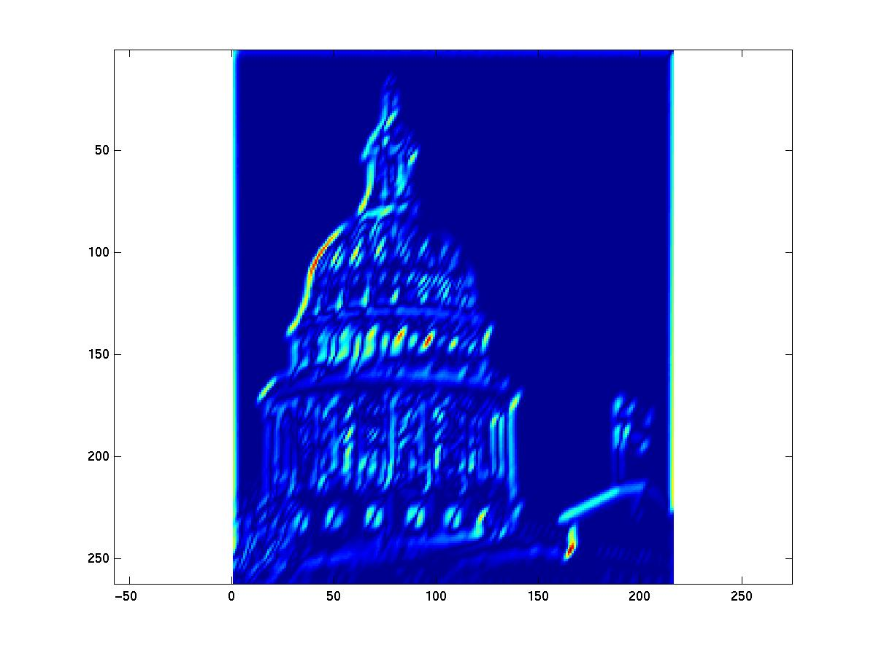
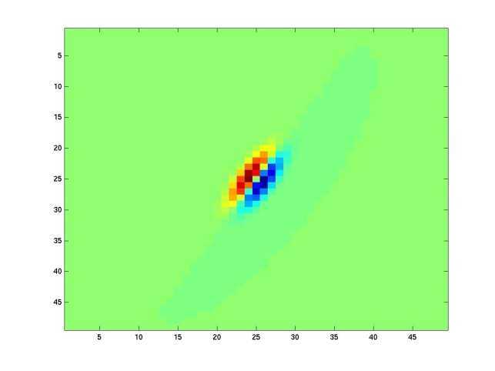
Kristen Grauman

Slide 38
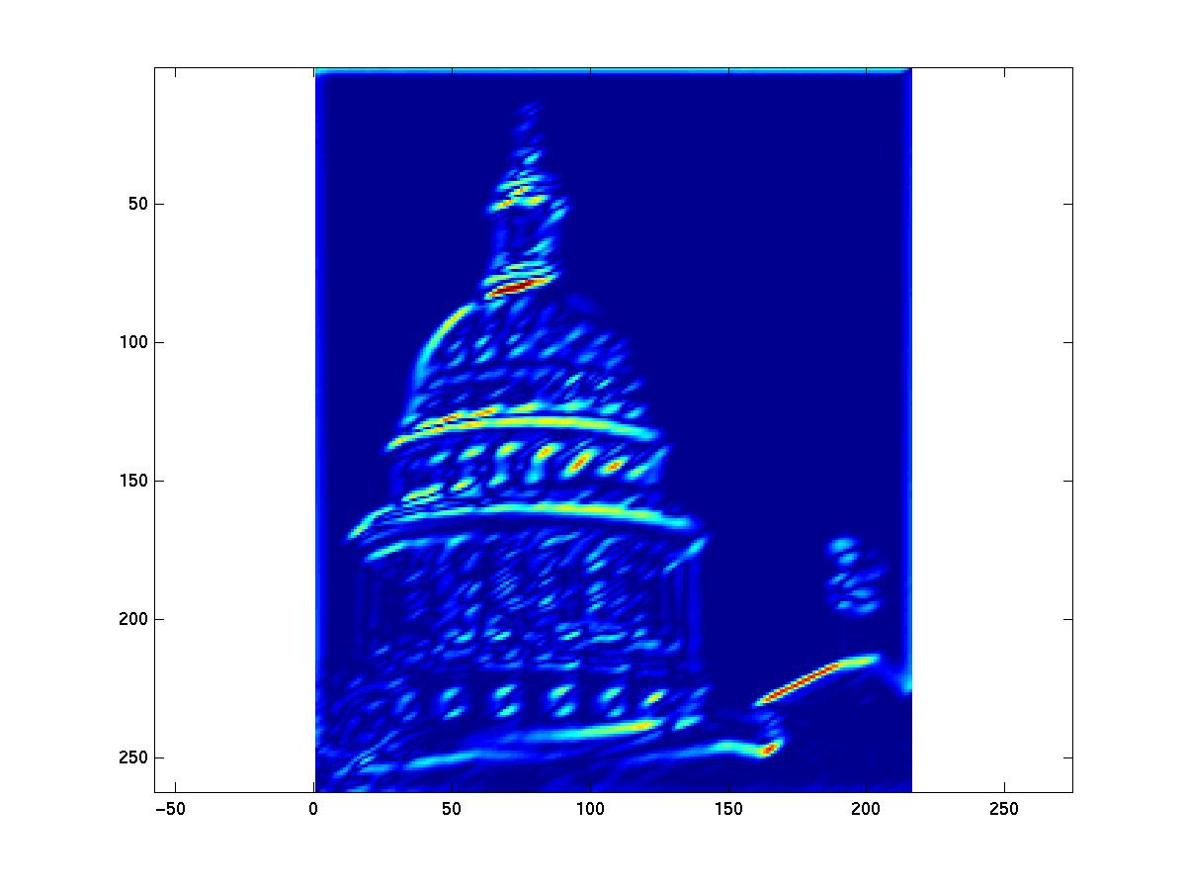
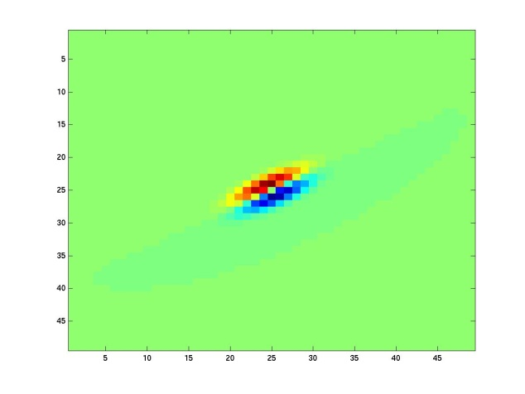
Kristen Grauman
Notes:
6

Slide 39
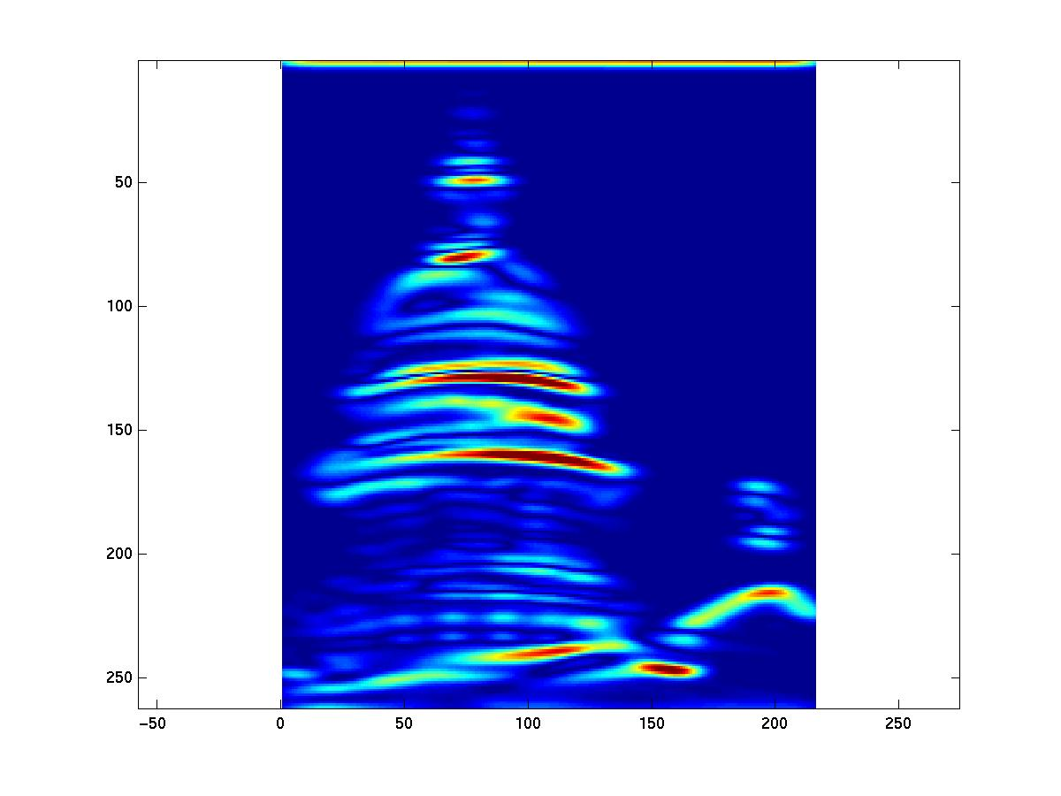
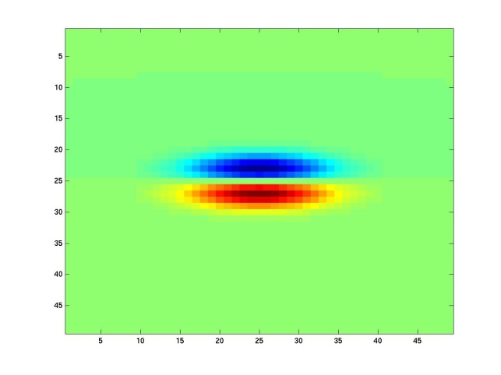
Kristen Grauman
Notes:
7

Slide 40
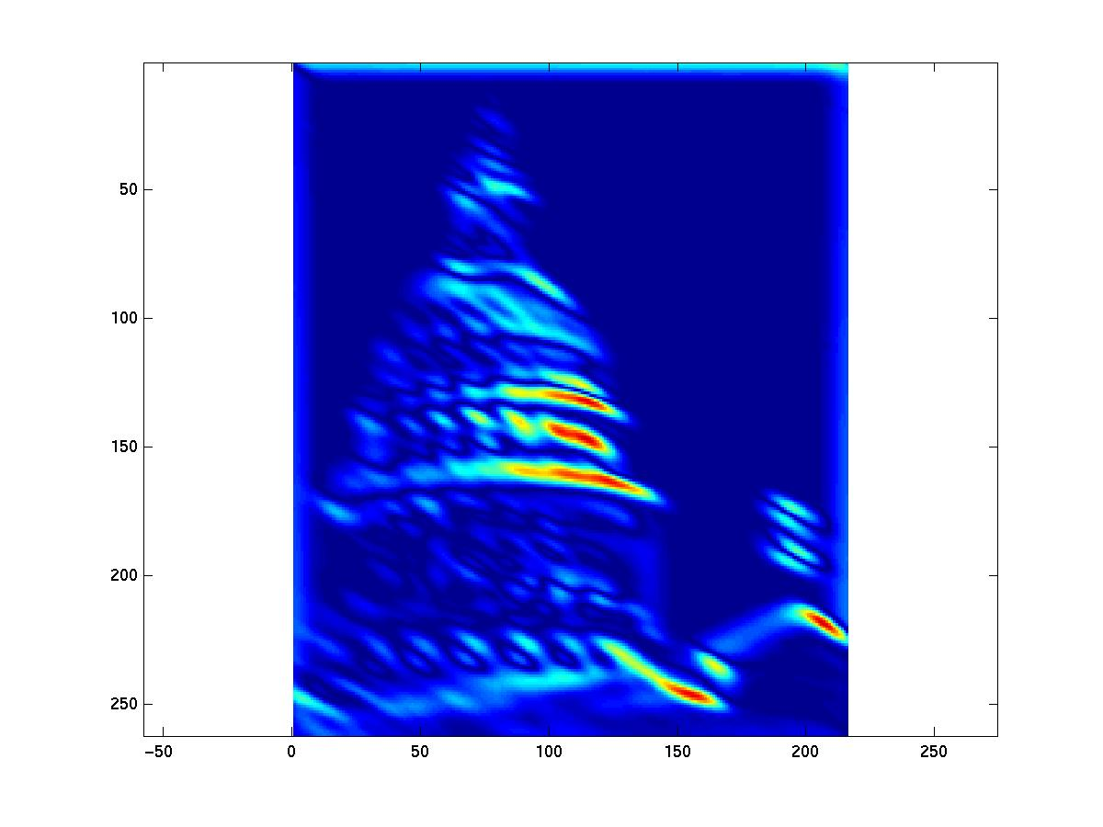
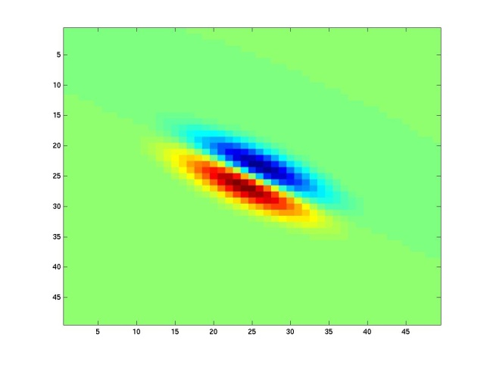
Kristen Grauman
Notes:
8

Slide 41
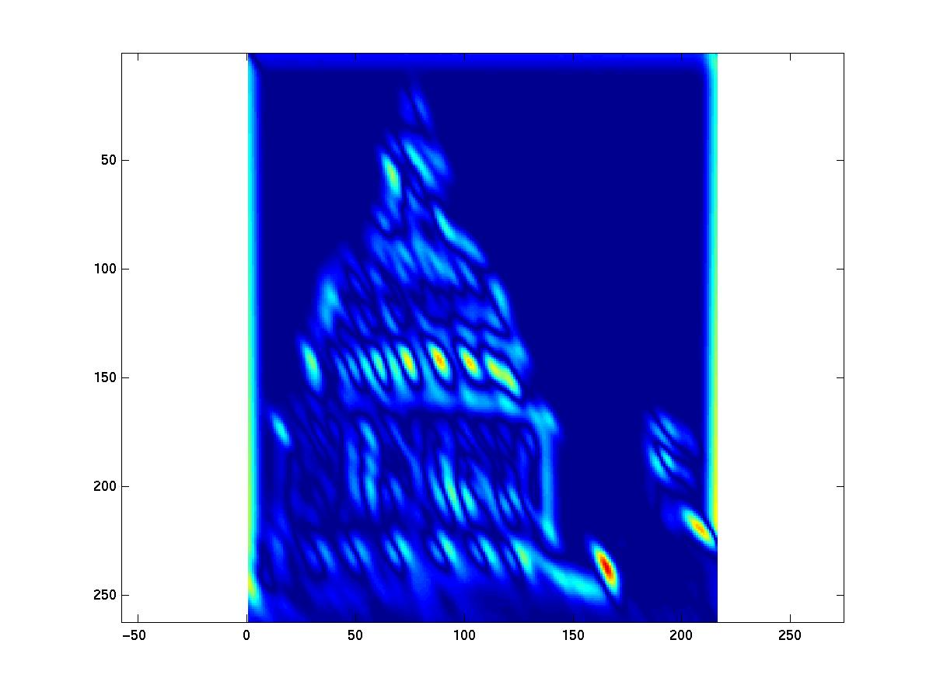
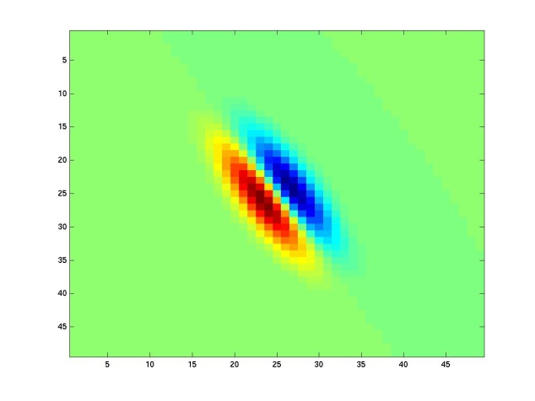
Kristen Grauman
Notes:
9

Slide 42
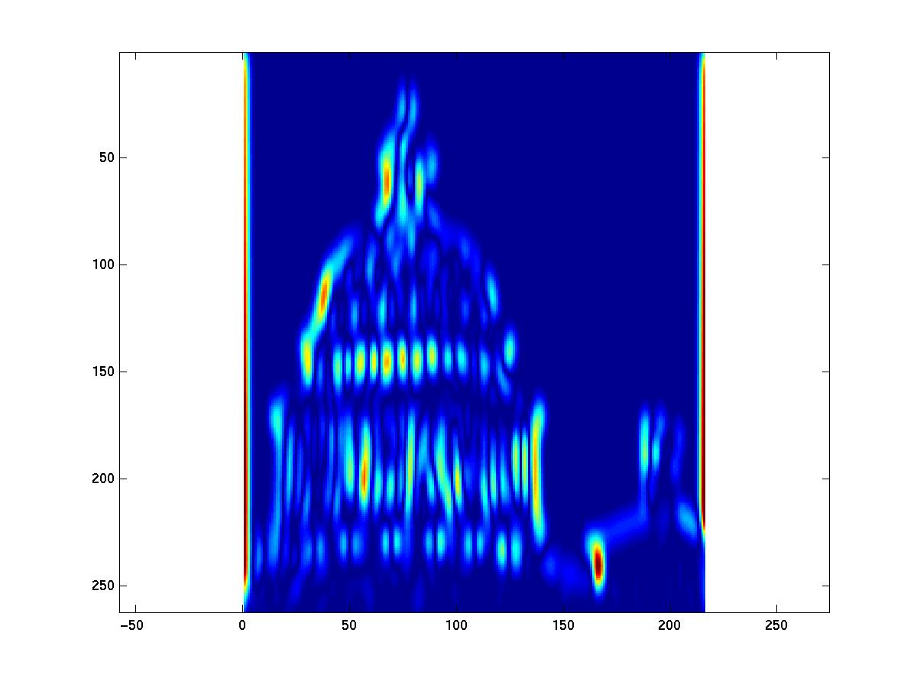
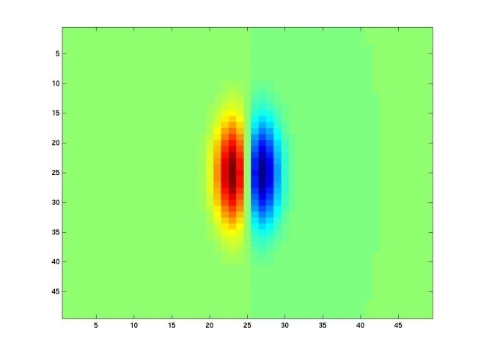
Kristen Grauman
Notes:
10

Slide 43
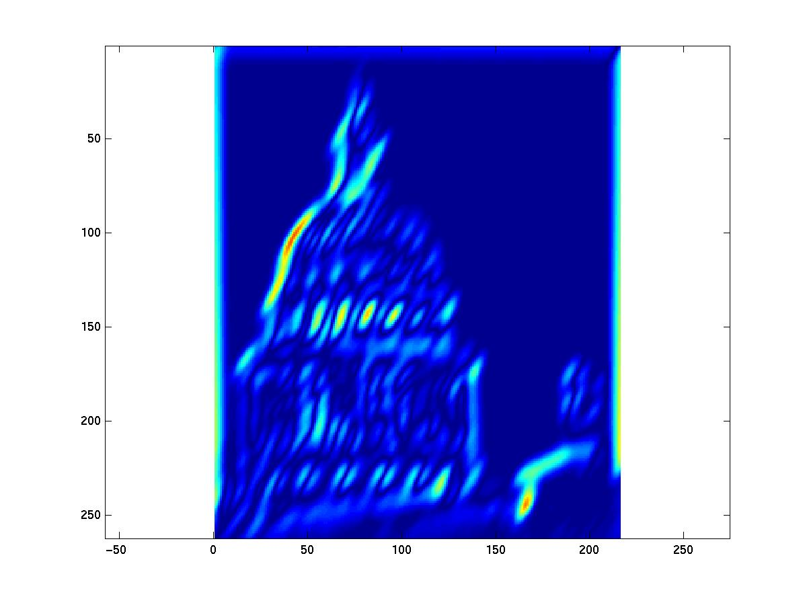
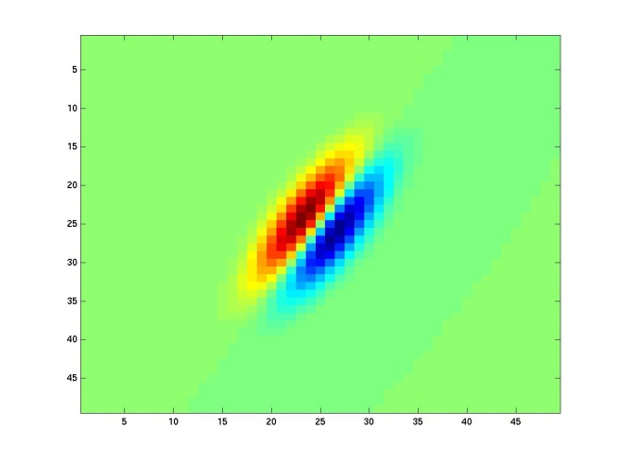
Kristen Grauman
Notes:
11

Slide 44
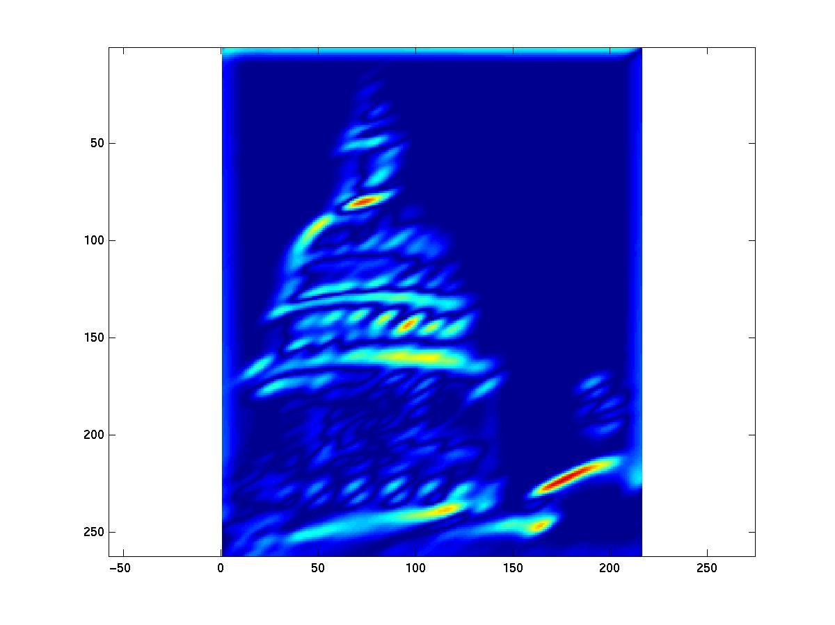
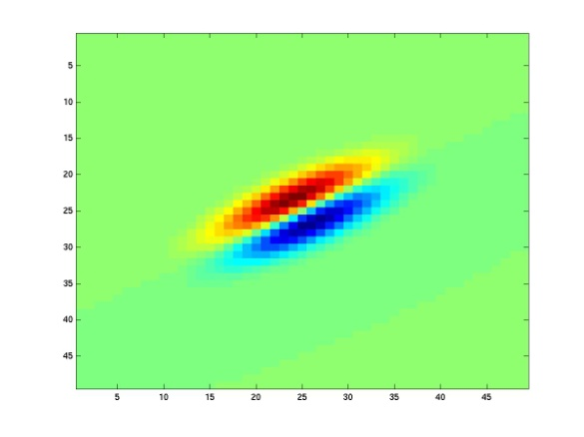
Kristen Grauman
Notes:
12

Slide 45
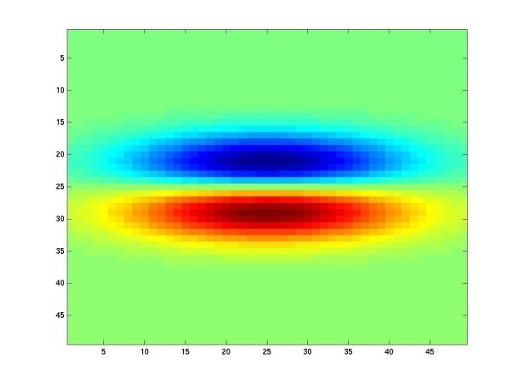
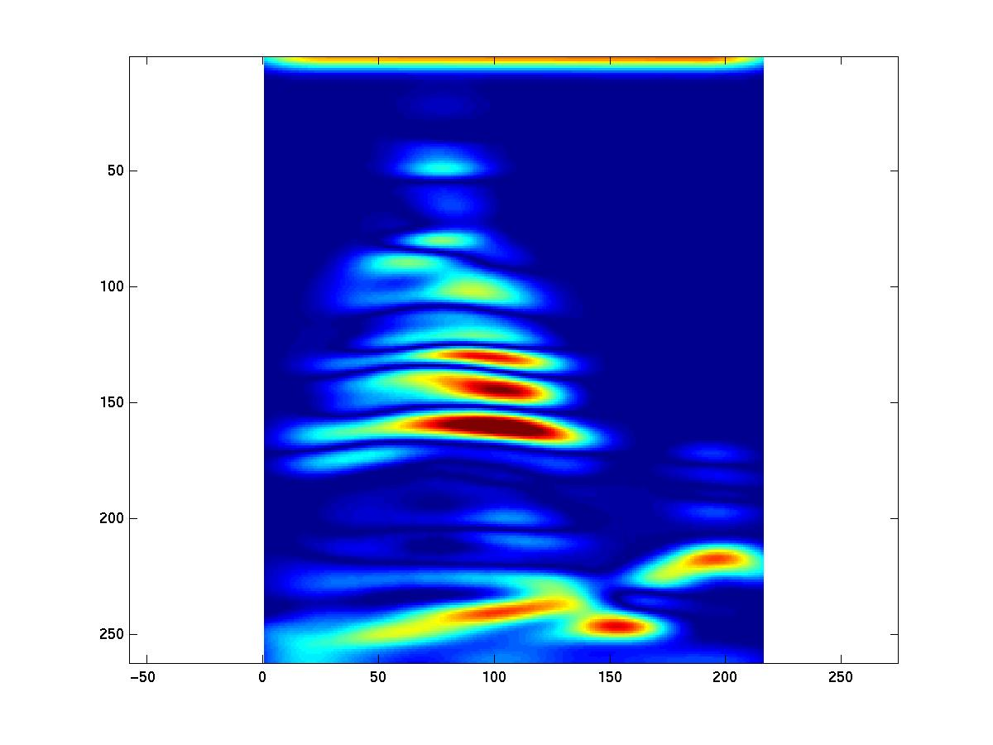
Kristen Grauman
Notes:
13

Slide 46
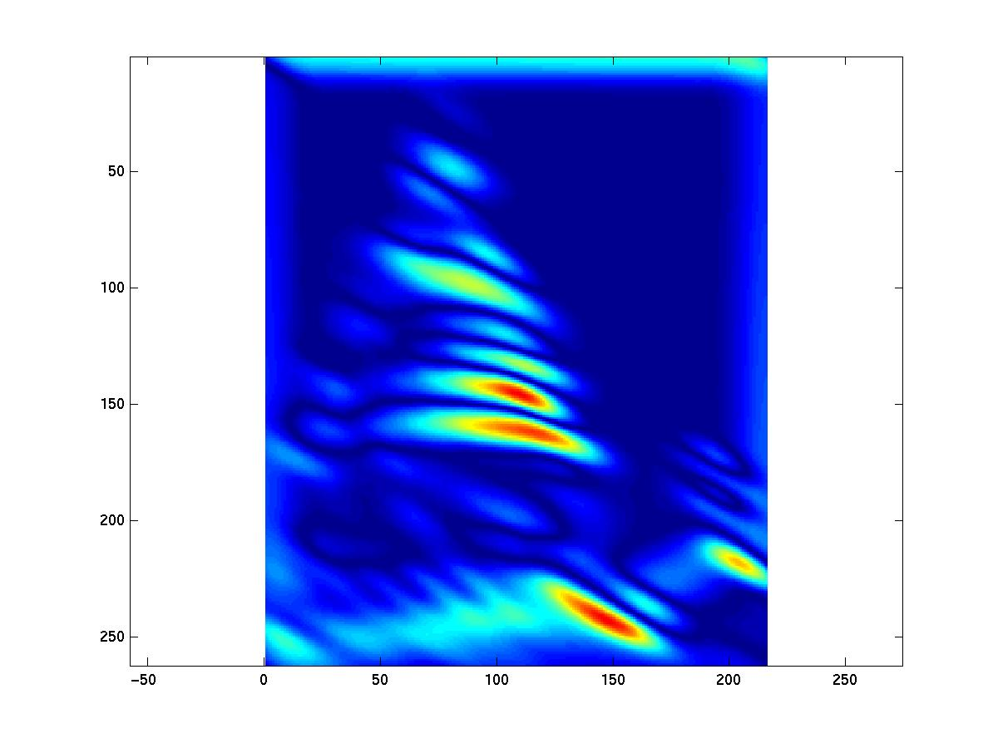
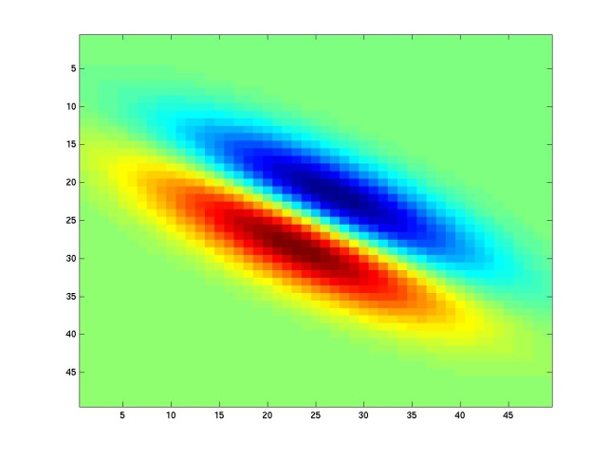
Kristen Grauman
Notes:
14

Slide 47
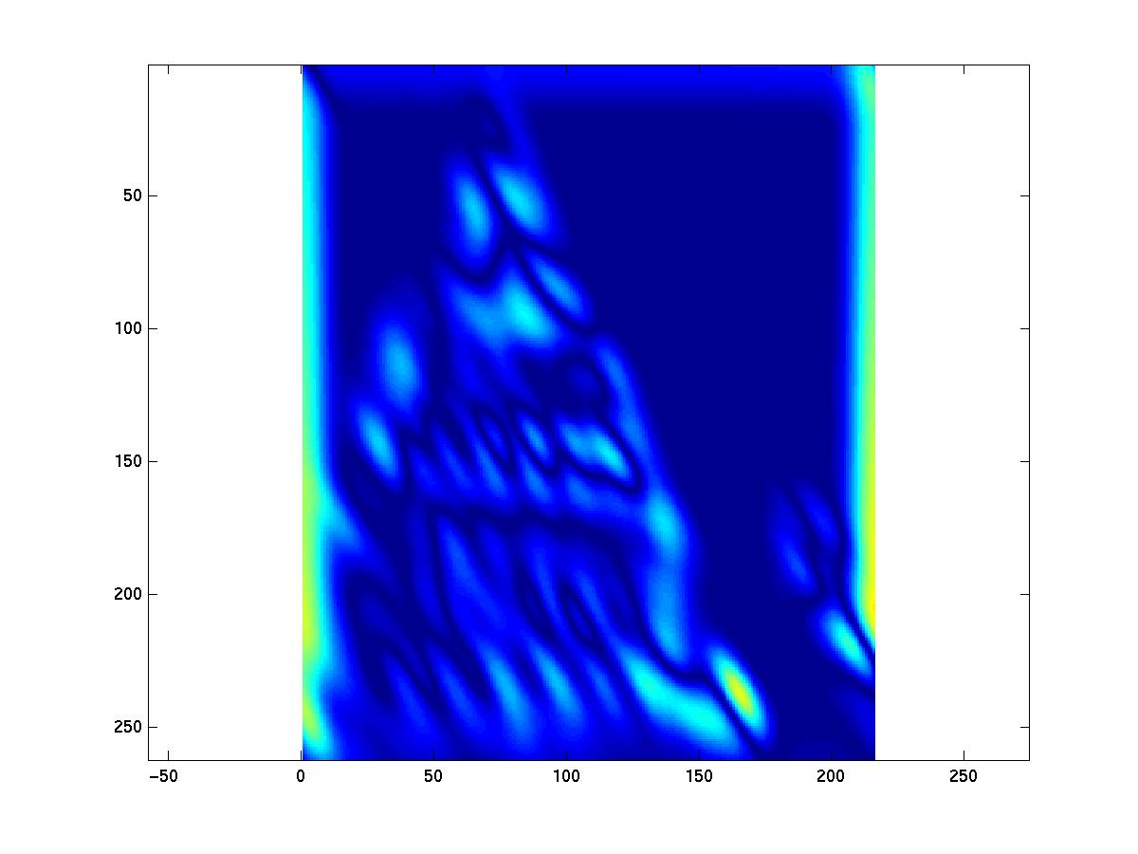

Kristen Grauman
Notes:
15

Slide 48


Kristen Grauman
Notes:
16

Slide 49


Kristen Grauman

Slide 50


Kristen Grauman
Notes:
18

Slide 51


Kristen Grauman

Slide 52
Vectors of texture responses
38 filters
To represent pixel, form a “feature vector” from the responses at that pixel.
1x38 vector
representation
feature
[r1, r2, …, r38]
Response
Filter ID
Adapted from Kristen Grauman

Slide 53
Vectors of texture responses
To represent pixel, form a “feature vector” from the responses at that pixel.
To represent image, compute statistics over all pixel feature vectors, e.g. their mean.
[r_{(1,1)}¹, r_{(1,1)}², …, r_{(1,1)}³⁸]
[r_{(1,2)}¹, r_{(1,2)}², …, r_{(1,2)}³⁸]
Pixel location (row, column)
Filter ID
…
[r_{(W,H)}¹, r_{(W,H)}², …, r_{(W,H)}³⁸]
[mean(r_{(:)}¹), mean(r_{(:)}²), …, mean(r_{(:)}³⁸)]

Slide 54
Quiz
Which of the following is not correct?
  Co-occurrence matrix is expensive to compute
  because there are many possible spatial relations to consider
  LBP is a good method for texture classification
  The limitation of the filter bank is that only one scale can be considered

Slide 55
Use of Texture
The use of color and texture together can work well for both recognition and segmentation.

